Slide 1
Food Production and Consumption Patterns in Namibia
Tasks 1-2
Secondary analysis of NHIES 2015/16 data to support the design and implementation of national food and nutrition policies
9 November 2020

Slide 2
Overview
Background
Methodology
Key Findings
Appendix
Summary of Methods
Data Tables

Slide 3
I. Background
The Food and Nutrition Security Policy and Implementation Action Plan (2019-2024) includes strategies to implement and strengthen mandatory fortification of staple foods and condiments.
Data and analyses on food production and consumption within households are required to appropriately inform the design and implementation of food and nutrition security policies.
From April 2015 to March 2016, the Namibia Statistics Agency undertook the Household Income and Expenditure Survey (NHIES).
The survey collected valuable information on household food production and consumption throughout the country, including a 7-day food diary.

Slide 4
II. Methodology
To better understand the household food production and consumption patterns within Namibia, a series of analyses were performed:
Analysis of household-level food consumption¹ and grain production² according to key demographics;
Comparison of regional cereal production data from MAWF and NHIES-derived estimates;
Mapping of regional and temporal variations in household-level grain consumption.
¹ Wheat, other cereals, rice, oil, and spices.
² Maize, mahangu (millet), sorghum, wheat, and other grains

Slide 5
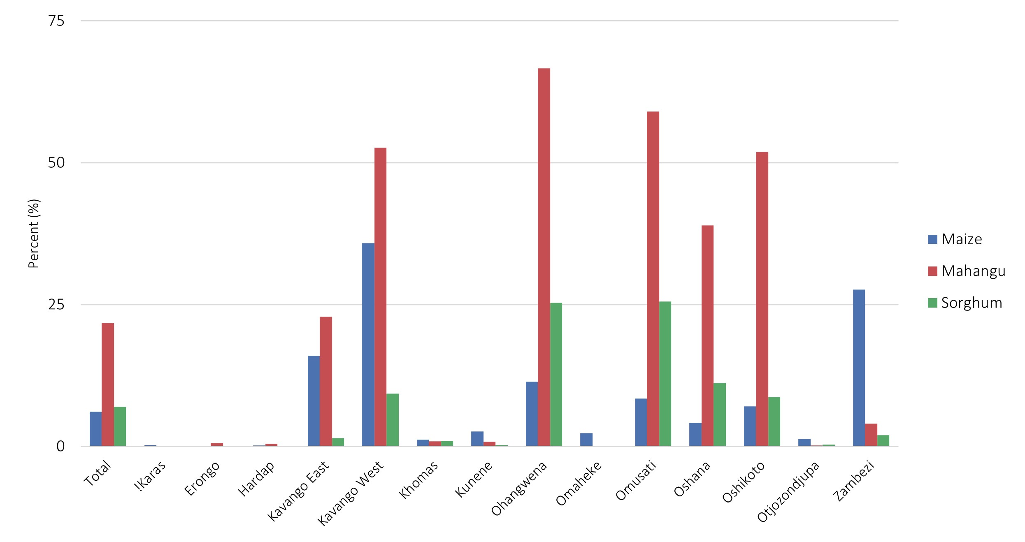
III. Key Findings
A. Analysis of household-level food consumption and grain production³
In the NHIES 2015/16, households were asked to report:
Foods consumed over the previous 7 days (and their source)
Detailed crop production information (if grown and quantities consumed, given away and sold)
Mahangu (millet), sorghum, and maize were grown by 22, 7, and 6 percent of NHIES households, respectively.⁴
Figure 1. Proportion of households growing maize, mahangu and sorghum
³ Data in Figure 1 based on analysis of information collected in the NHIES 2015/16 NHIES household questionnaire. A summary of data presented in chart can be found in Appendix B, Table 1.
⁴ A negligible proportion of households reported growing wheat (0.05%)

Slide 6
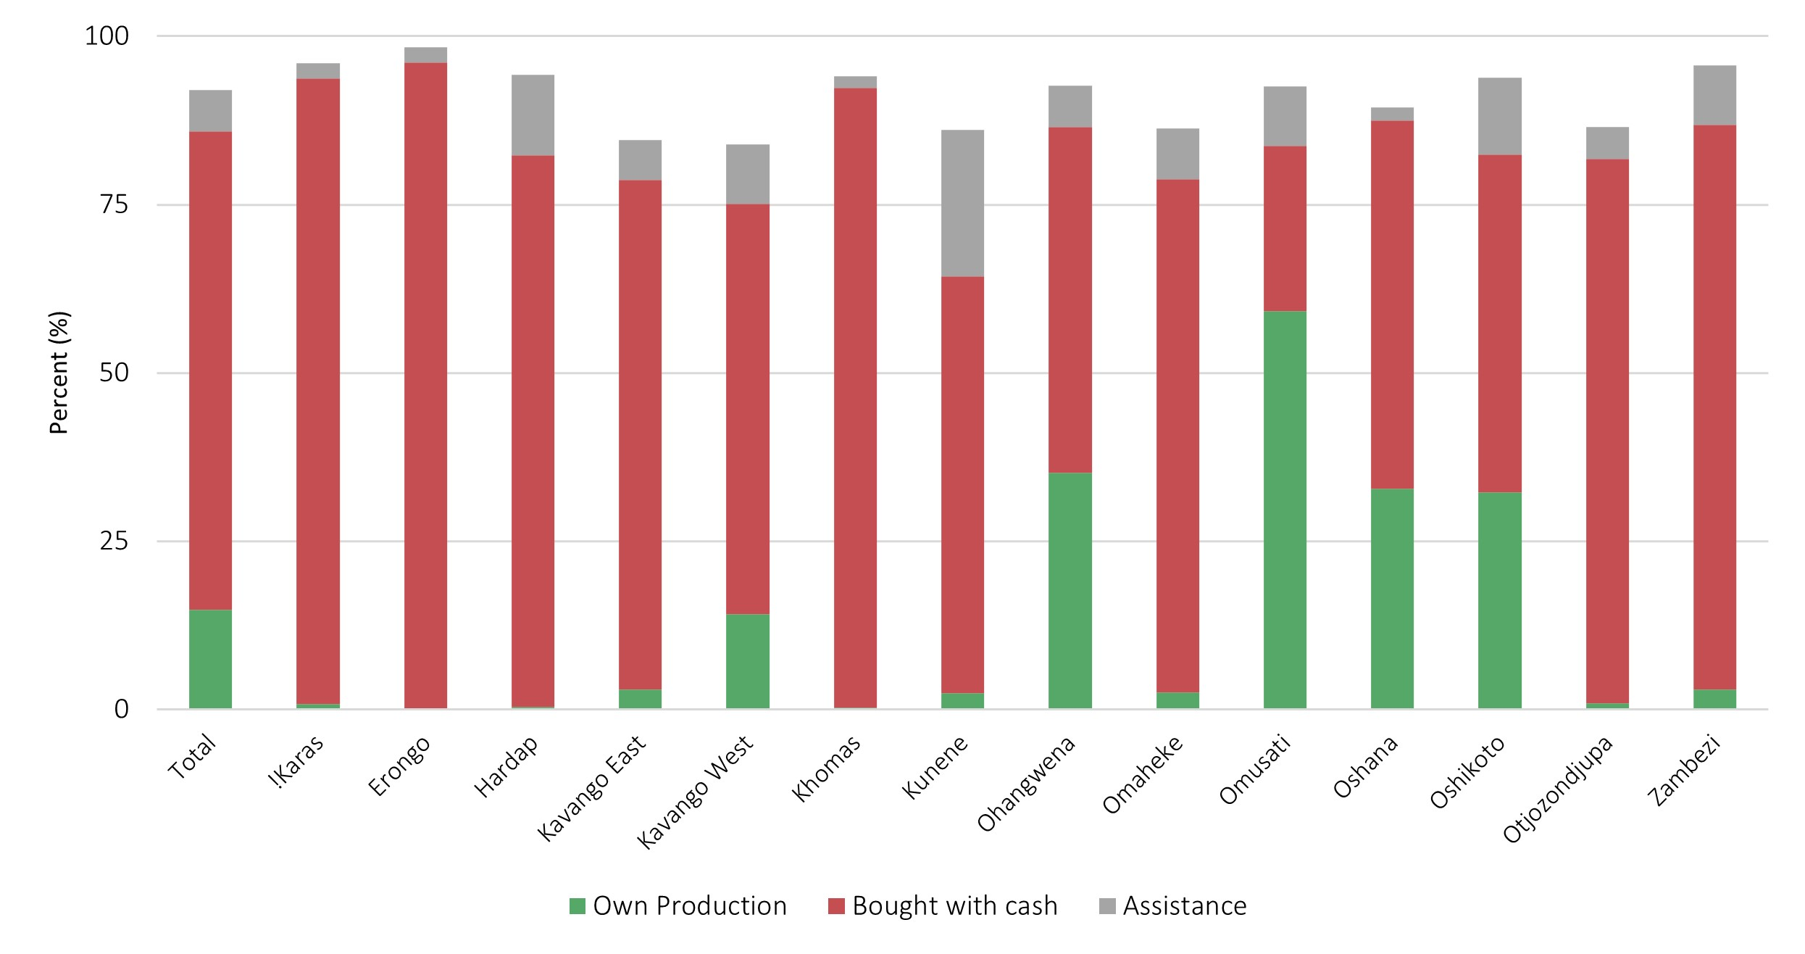
III. Key Findings
A. Analysis of household-level food consumption and grain production
A large majority of households in the NHIES 2015/16 reported consuming “other cereals”⁵ in the week prior to the survey (82 percent).⁶ By comparison, the proportions which consumed wheat flour/bread and rice were 72 percent and 52 percent, respectively.
Figure 2. Proportion of households consuming "other cereals" and source of "other cereals”
The main source of these “other cereals” varied by location, income, and ethnic group:
Households in regions with low overall grain production more often purchased “other cereals”
87 percent of households in the highest income bracket reported buying these “other cereals” with cash compared to just 59 percent of households in the lowest income bracket.
⁵ “Other cereals” is defined in the household questionnaire, Module 2E, as “maize, sorghum, millet, barley…” NB: The “other cereals” category does not include wheat flour/bread and rice – these are captured separately.
⁶ See Appendix A for limitations of this analysis and Appendix B, Table 2 for summary of data presented in chart.

Slide 7
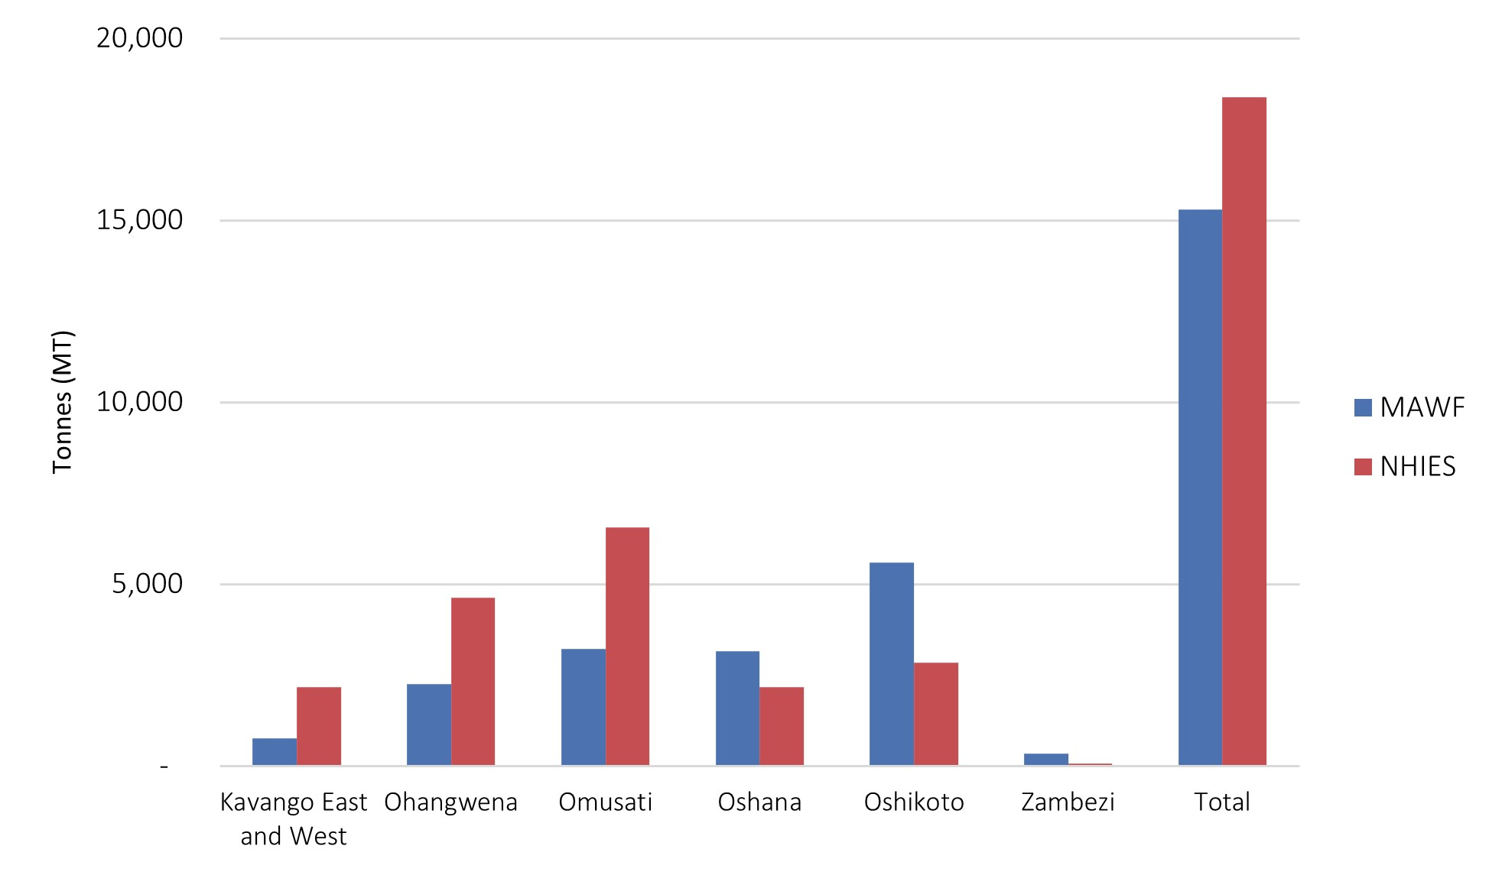
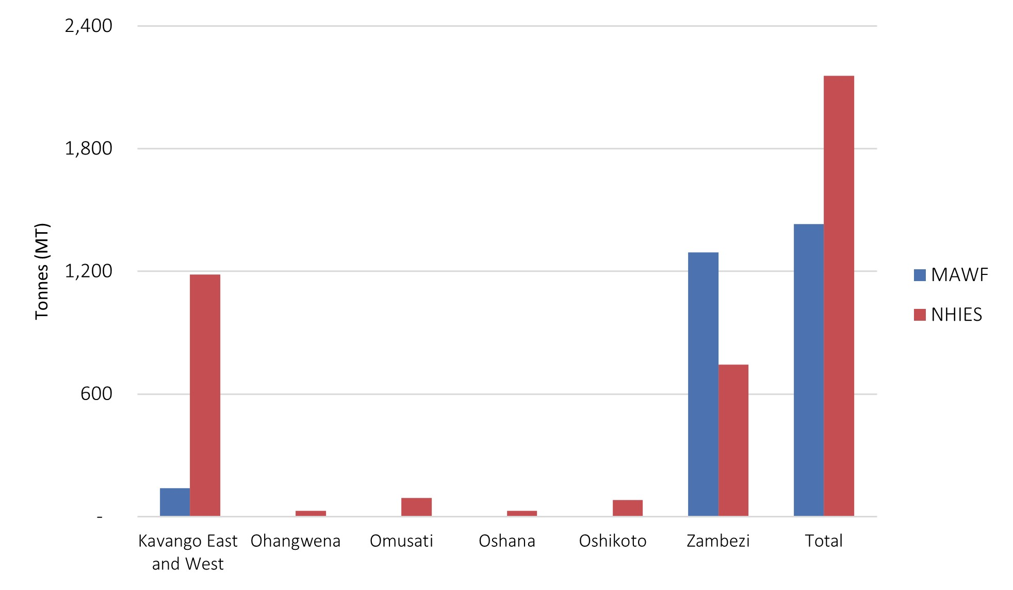
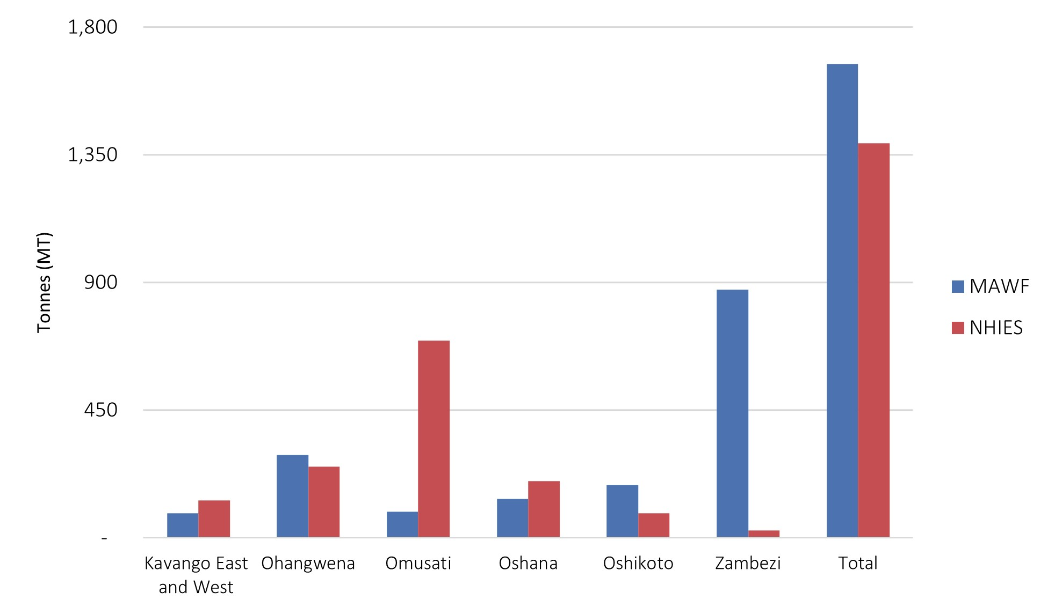
III. Key Findings
Figure 4. Comparison of MAWF and NHIES (est.) communal mahangu production
B. Comparison of regional cereal production data: MAWF and NHIES (est.)⁷
Estimates of regional crop production (MT) from NHIES correlated reasonably well with communal crop production data collected by MAWF.
Figure 3. Comparison of MAWF and NHIES (est.) communal maize production
Figure 5. Comparison of MAWF and NHIES (est.) communal sorghum production
⁷ Because the NHIES began collecting data in late April/early May 2015 -- just before the main harvest period – the derived production estimates were compared with 2014/15 MAWF crop production statistics (see Appendix A for details on methodology and Appendix B, Table 3 for summary of data presented in charts).

Slide 8
III. Key Findings
C. Regional and temporal variations in “other cereals” and grain consumption
A majority of households purchased the “other cereals” (grains) they consumed because most communal maize, manahgu and sorghum production in Namibia is rainfed and small-scale (see Fig. 2)
Wheat, which is almost exclusively imported, is commercially milled and the majority is purchased and consumed as bread or other derived products;
Maize is both commercially (rainfed and irrigated) and communally grown but a significant proportion is also imported. Imported and commercially grown maize make up the majority of maize for consumption;⁸
Most available mahangu is from communal production (with limited imports) but is primarily grown in the 6 northern regions where growing conditions are favourable.
However, one concern is that in the regions where communal production is common, especially during and after the harvest season,⁹ a micronutrient fortification programme which targets imports and commercially milled grain might not reach key segments of the population.
To explore this issue, data from the household questionnaire and 7-day food diary were aggregated and analysed according to the month in which the survey was conducted.
⁸. See NAB annual reports for more details
⁹ In Namibia, rainfed maize, mahangu and sorghum -- which represent the primary grains consumed in Namibia (and, thus, the main components of “other cereals”) – are normally harvested between May and August

Slide 9
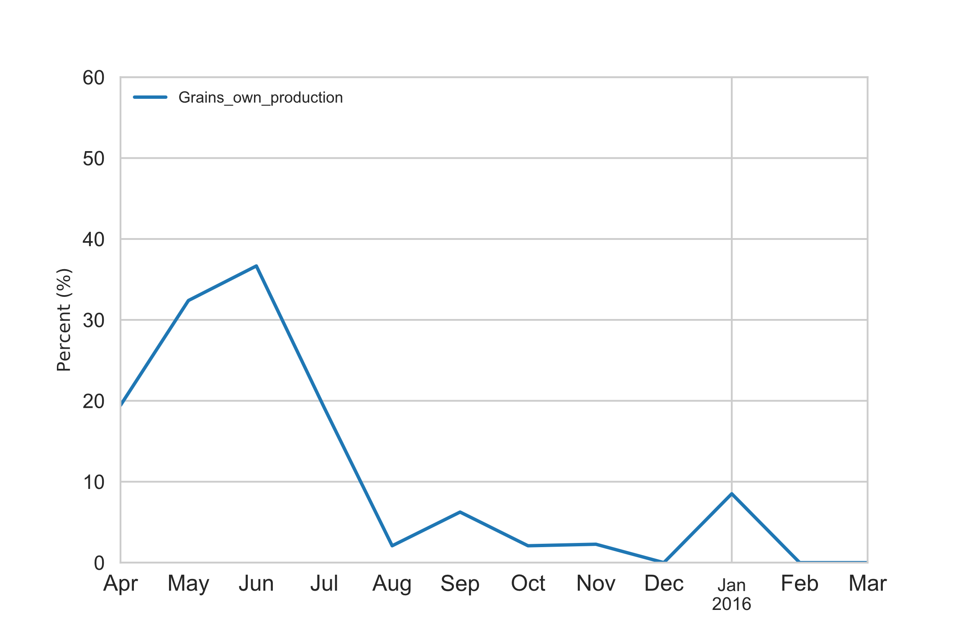
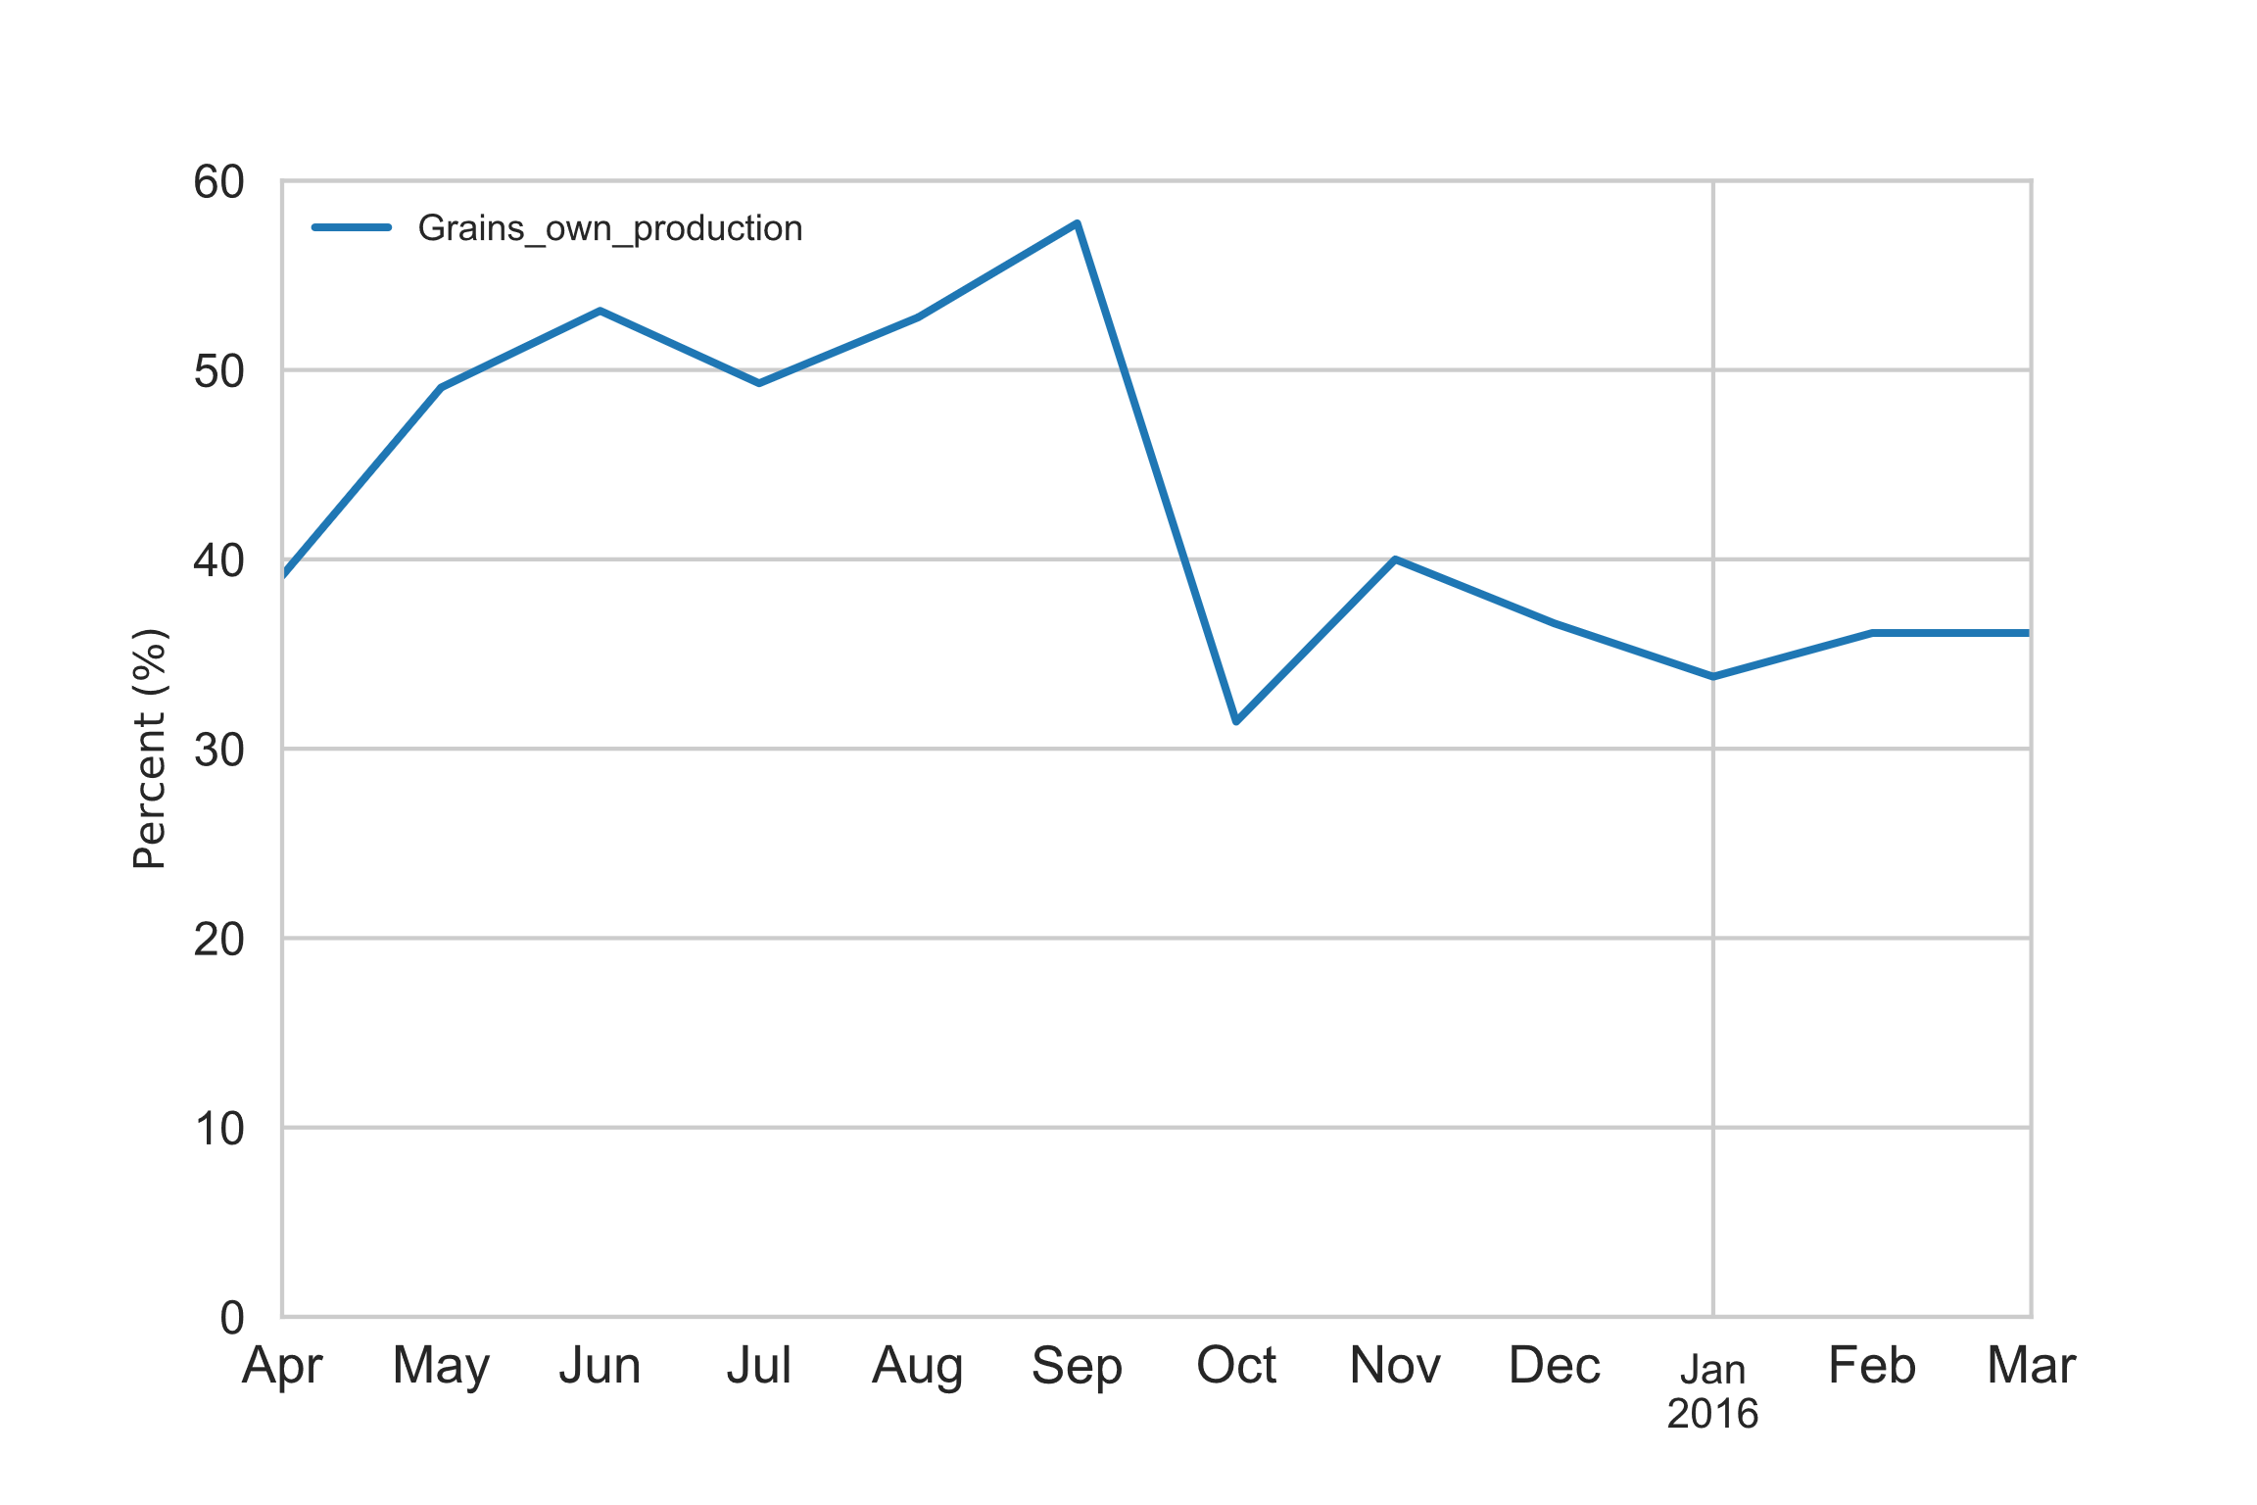
III. Key Findings
C. Regional and temporal variations in grain consumption
Data from the household questionnaire revealed that consumption of “other cereals” from own production was highest during and following the main harvest period (May-August) in regions where communal production is common (see Figs. 6 & 7)¹⁰
Figure 6. Proportion of households consuming “other cereals” from own production in Kavango West between April 2015 and March 2016
Figure 7. Proportion of households consuming “other cereals” from own production in Omusati between April 2015 and March 2016
¹⁰ Data from Kavango West and Omusati regions are depicted because they have high levels of communal maize and mahangu production, respectively (see Figures 3 & 4 above)

Slide 10
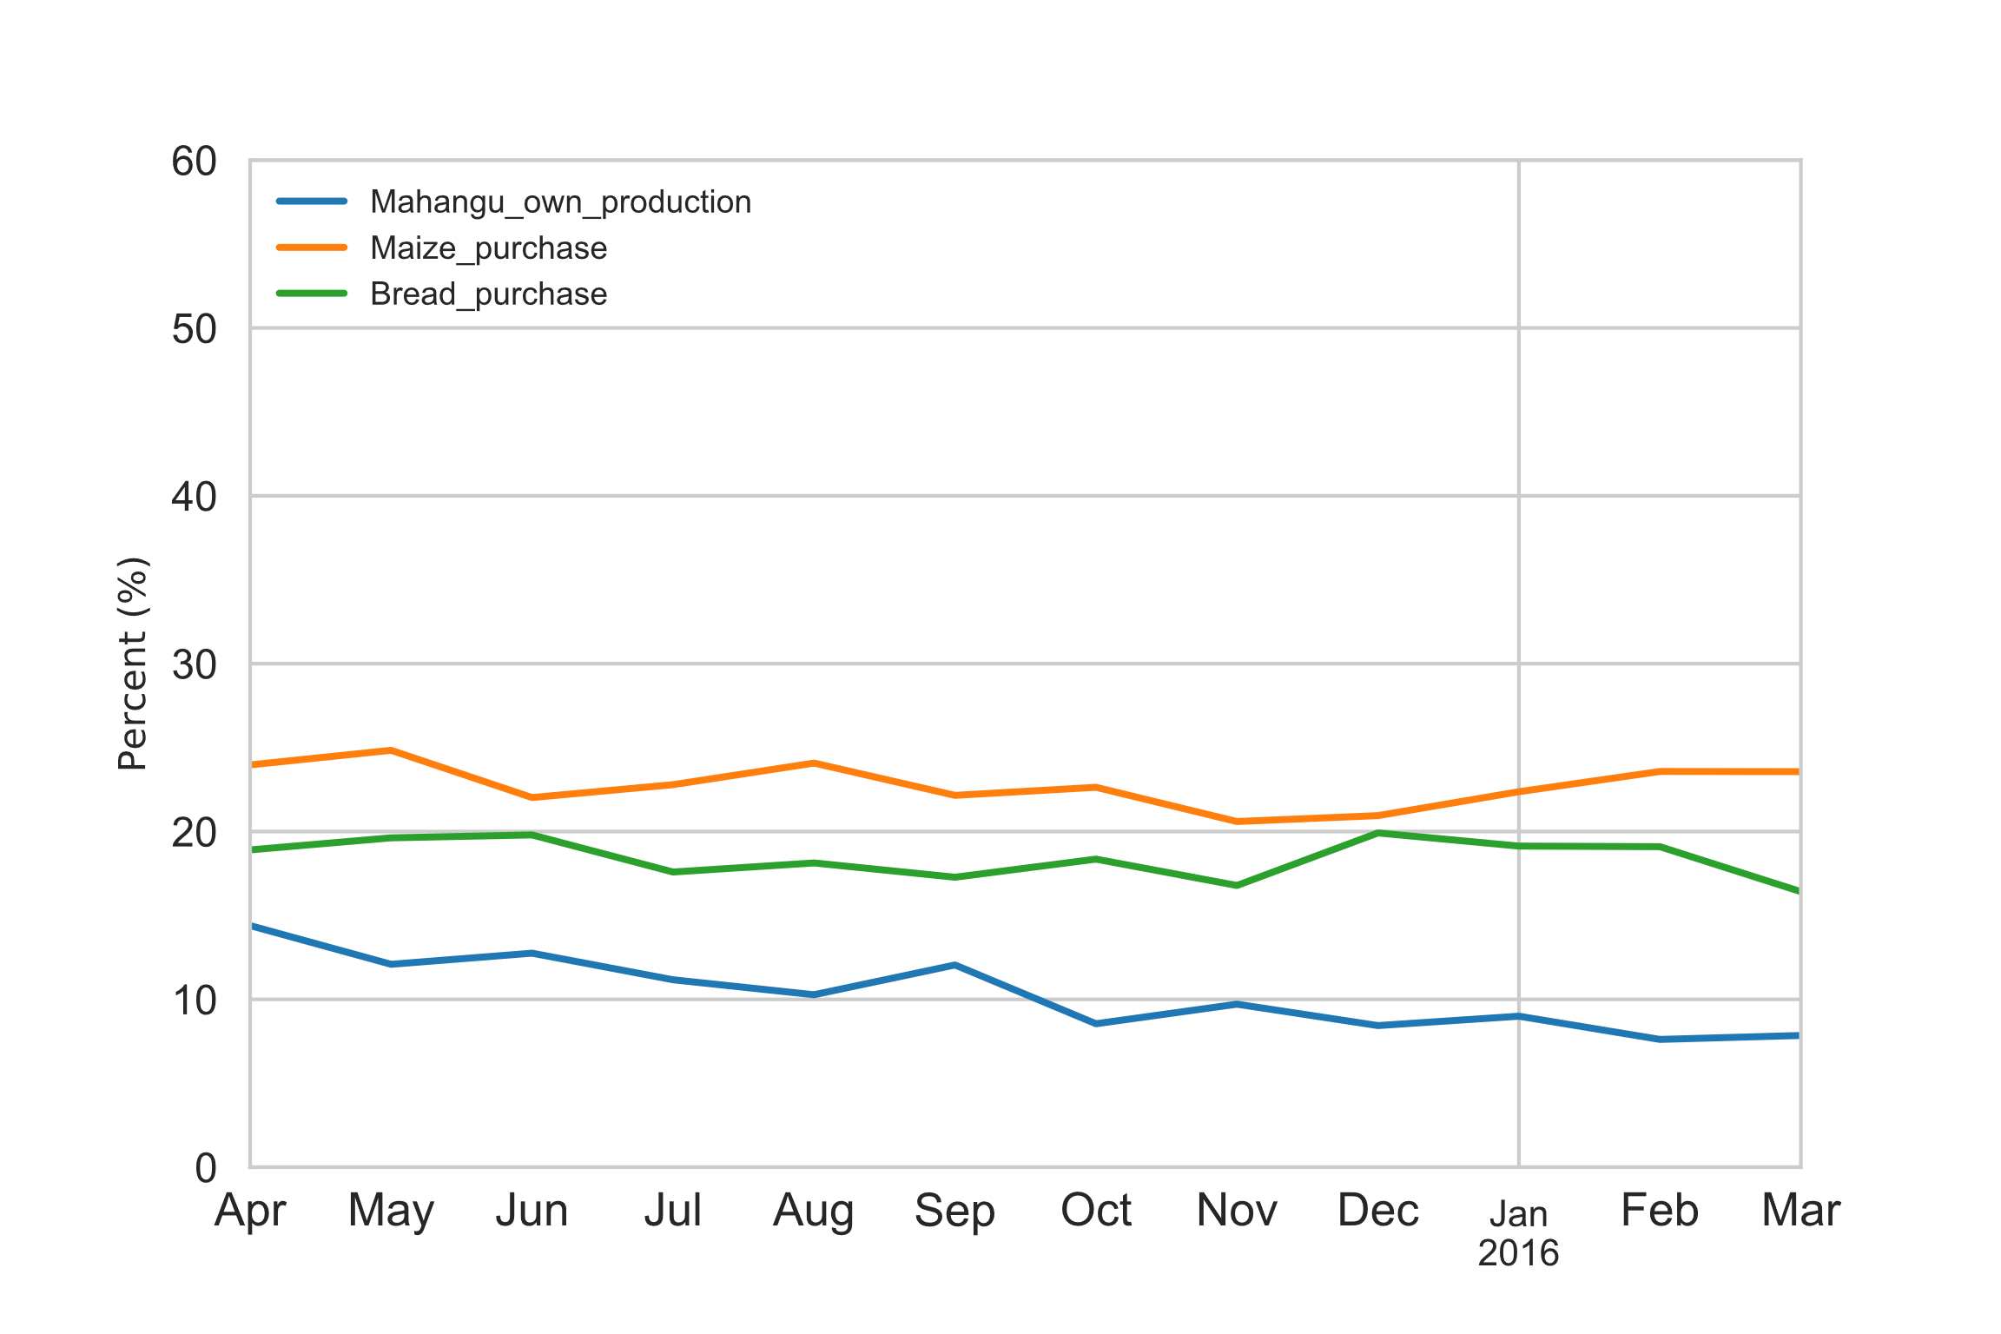
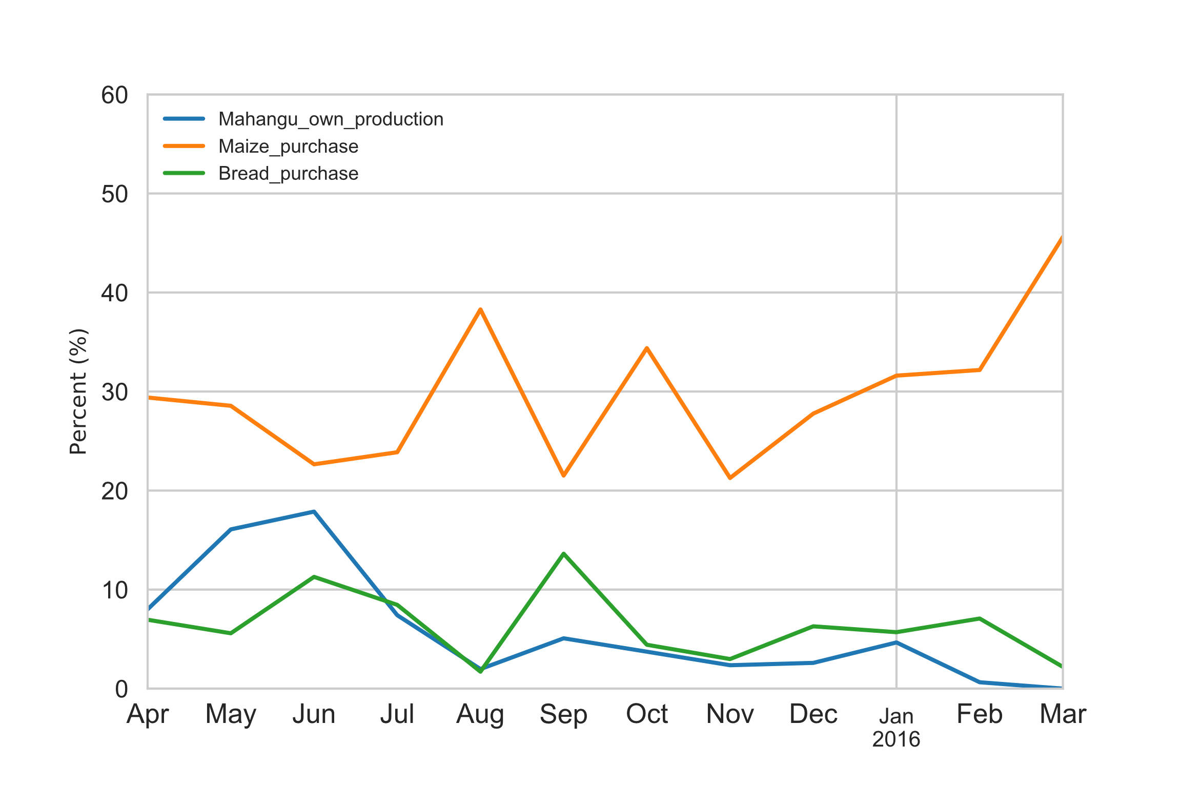
III. Key Findings
Figure 8. Consumption of grains products in Namibia as a percentage of total food servings between April 2015 and March 2016
C. Regional and temporal variations in grain consumption
One finding from the 7-day food diary: of maize, mahangu and sorghum, mahangu is the only grain frequently consumed from own production. This is somewhat intuitive when considering the overall quantities produced (see Figs. 3, 4, & 5)¹¹
Analyses of mahangu consumption from own production from the 7-day food diary reveal a similar regional and temporal pattern as observed for “other cereals” from the household questionnaire (Figures 8 & 9 below)¹²
Figure 9. Consumption of grains products in Kavango West as a percentage of total food servings between April 2015 and March 2016
¹¹ The 7-day food diary, unlike the household questionnaire, contained more detailed information on the food consumed and allowed for analysis of specific grains
¹² Kavango West region was chosen as an example of temporal grain consumption patterns; all regions with communal mahangu production had similar patterns of cereal consumption. Other forms of grain consumption were not depicted (e.g., maize from own production) due to very small values.

Slide 11
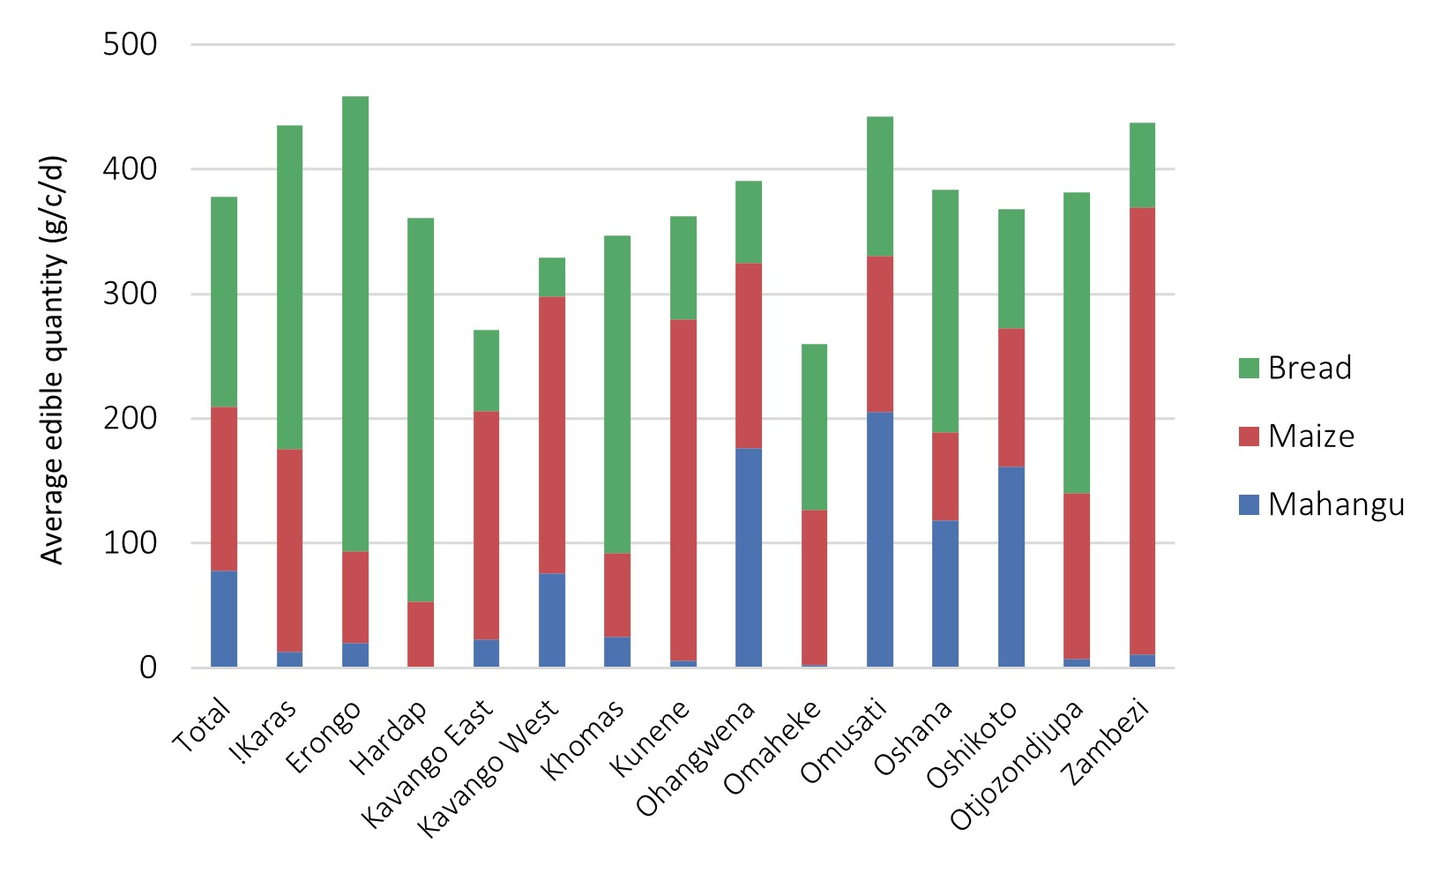
III. Key Findings
C. Regional and temporal variations in grain consumption
However, consumption of purchased maize and bread – items likely to be fortified – remain a significant part of food consumed (in g/c/day) throughout the year even in regions with significant communal mahangu production (Figure 10).
Figure 10. Quantity of cereals and cereal products consumed by region

Slide 12
IV. Appendix A: Summary of Methods
Analysis files, including detailed source code, comprehensive tables and charts/graphs can be found HERE.

Slide 13
A. Analysis of household-level food consumption and grain production according to key demographics
Data Sources: NHIES 2015/16 Household Dataset file
Software: Python 3.8
Analysis Process: Weighted frequencies and means were calculated for variables of interest from Sections 2E and 7 of the household questionnaire.
Limitations: The household dataset/questionnaire did not allow analysis of consumption by specific grain type (e.g., maize, mahangu, and sorghum) – these were all lumped together under the “other cereals” category in Section 2E.

Slide 14
B. Comparison of regional cereal production data from MAWF, NAB and NHIES
Data Sources: NHIES 2015/16 Household Dataset file; MAWF regional crop production data; NAB commercial and import data; Namibia Inter-censal Demographic Survey
Software: Python 3.8
Analysis Process: Twenty years of regional (communal) crop production data were obtained from MAWF. Ten years of import and commercial crop production data were sourced from NAB and annual reports. To calculate regional production estimates from NHIES data, the weighted median amount grown in each region was multiplied by the % of households growing the crop and the number of households in the region according to Inter-censal Survey 2016.
Limitations: MAWF only collects/records maize crop production estimates for high-production regions (East and West Kavango, Zambezi) which made comparison with other regions impossible. NHIES likely captured at least one large-scale (or commercial) maize and mahangu operation. Medians were used to minimize the impact of these outliers. While NHIES crop production data relies on households’ verbal reports, MAWF uses more sophisticated methods to calculated their estimates – this may help explain some discrepancy.

Slide 15
C. Mapping of regional and temporal variations in household-level grain consumption
Data Sources: NHIES 2015/16 Household Dataset file and Daily Record Book Dataset file
Software: Python 3.8
Analysis Process: A clean survey date variable [start_date] was created based on [ah_start_date] from the household questionnaire dataset. This household dataset was then sorted according to this variable and implausible entries removed (i.e. before April 2015). The dataset was then grouped by month and region and the weighted mean of households reporting consuming “other cereals” from own production was calculated.
For the 7-day food diary analysis, the same date variable was used (merged into 7-day food diary dataset using a unique household identification number [hhid]) and the same grouping process applied. However, the DRB contains counts of food items consumed over a 7-day period; therefore, the denominator is NOT total households (as above) but total number of food items consumed over a 7-day period.
Limitations: The NHIES 2015/16 started and ended data collection just before harvest season which makes visualization of seasonal consumption trends slightly more difficult.

Slide 16
IV. Appendix B: Data Tables
Table 1. Proportion of households which reported growing mahangu, maize and sorghum (NHIES 2015/16)
Region | Mahangu (%) | Maize (%) | Sorghum (%) | N
!Karas | 0.1 | 0.3 | 0.0 | 559
Erongo | 0.6 | 0.1 | 0.1 | 828
Hardap | 0.5 | 0.2 | 0.1 | 561
Kavango East | 22.9 | 16.0 | 1.5 | 554
Kavango West | 52.7 | 35.9 | 9.3 | 568
Khomas | 0.9 | 1.2 | 1.0 | 1,084
Kunene | 0.8 | 2.7 | 0.3 | 570
Ohangwena | 66.6 | 11.4 | 25.3 | 854
Omaheke | 0.0 | 2.3 | 0.0 | 557
Omusati | 59.0 | 8.4 | 25.5 | 854
Oshana | 38.9 | 4.2 | 11.2 | 846
Oshikoto | 51.9 | 7.0 | 8.7 | 852
Otjozondjupa | 0.2 | 1.4 | 0.3 | 837
Zambezi | 4.0 | 27.7 | 2.0 | 566
Total | 21.8 | 6.1 | 7.0 | 10,090

Slide 17
IV. Appendix B: Data Tables
Table 2. Among households consuming “other cereals” in 7 days before survey, proportion reporting main source as purchased, own production, and assistance (NHIES 2015/16)
Region | Bought with cash (%) | Own production (%) | Assistance (%) | N
!Karas | 92.9 | 0.9 | 2.3 | 423
Erongo | 96.0 | 0.1 | 2.3 | 604
Hardap | 81.9 | 0.4 | 12.0 | 493
Kavango East | 75.7 | 3.0 | 5.9 | 475
Kavango West | 60.9 | 14.2 | 8.9 | 505
Khomas | 92.1 | 0.2 | 1.7 | 862
Kunene | 62.0 | 2.4 | 21.7 | 531
Ohangwena | 51.3 | 35.2 | 6.2 | 700
Omaheke | 76.2 | 2.5 | 7.6 | 484
Omusati | 24.5 | 59.2 | 8.9 | 645
Oshana | 54.7 | 32.8 | 1.8 | 698
Oshikoto | 50.1 | 32.3 | 11.5 | 774
Otjozondjupa | 80.9 | 0.9 | 4.8 | 684
Zambezi | 83.9 | 3.0 | 8.9 | 549
Total | 71.1 | 14.8 | 6.1 | 8,427

Slide 18
IV. Appendix B: Data Tables
Table 3. Estimated communal production (MT) of maize, mahangu and sorghum in key administrative areas (NHIES 2015/16 and MAWF 2014)
 | Maize |  | Mahangu |  | Sorghum
Region | MAWF | NHIES | MAWF | NHIES | MAWF | NHIES
Kavango East and West | 139 | 1,184 | 763 | 2,166 | 87 | 132
Ohangwena | --- | 28 | 2,258 | 4,615 | 292 | 251
Omusati | --- | 92 | 3,213 | 6,550 | 92 | 695
Oshana | --- | 28 | 3,156 | 2,168 | 138 | 199
Oshikoto | --- | 80 | 5,581 | 2,829 | 186 | 87
Zambezi | 1,293 | 745 | 331 | 54 | 876 | 26
Total | 1,432 | 2,157 | 15,302 | 18,382 | 1,671 | 1,390

